Slide 1


Reworking Indexes for an Evolving Application
Courtney Woolum

Slide 2






Courtney Woolum
Fulltime DBA
Performance Tuning Focused
Champion of making more work for myself
Documentation Fiend
@datacourt.bsky.social SereneFireSiren Courtney-Woolum

Slide 3




Agenda
Admit There’s a Problem
Gather Intel
Collect Metrics
Strategy for Attack

Slide 4
What It Looks Like
Navigation slowness
Timeouts
High Waits
Inconsistent performance
But ultimately…
Loading……
No one screen is the problem
The timeout period elapsed prior to completion of the operation or the server is not responding.
Notes:
Screen to screen
- Buttons or pop-ups

Slide 5
Common Culprits
Performance Focus
Structure Focused
Monster procs
Tuning per query
No upkeep
Missing Index suggestions
Wide tables
Too many indexes

Slide 6

“Seek to understand, then to be understood.” Stephen Covey The 7 Habits of Highly Effective People

Slide 7











User Experience
What is the app for?
Use cases
Response Times
High traffic screens
Media
Cast & Crew
People

Slide 8







“Who Is That Actor?”
Sir Ian McKellen
Fellowship of the Ring
Boromir
Frodo
Gandalf
Legolas

Slide 9
Developer Experience
Data Retrieval
Design Standards
Object Relational Mapping (ORM)
Stored Procedures
Dynamic SQL
Foreign Keys & Cascade
Normalization
Logging
Notes:
A lot to unpack

Slide 10

“If I had five minutes to chop down a tree, I’d spend the first three sharpening my axe.”

Slide 11
Meet Your Friends
Built-In Tools
System Objects
Query Store (2016+)
Activity Monitor
Extended Events
They’re not as scary as you think
To name a few
sys.dm_db_index_usage_stats
sys.dm_exec_requests
sys.dm_exec_sql_text
Notes:
Offer scripts at the end
sys.dm_exec_requests – Executing queries
sys.dm_exec_sql_text – Text based on request handle

Slide 12


& Make Some New Ones
*
RedGate SQL Monitor
Plan Explorer (Free)
Database Performance Analyzer
SQL Sentry
StatisticsParser.com
SET STATISTICS IO ON;
SET STATISTCS TIME ON;
* No I’m not a sponsor, I just use their tools a lot!

Slide 13
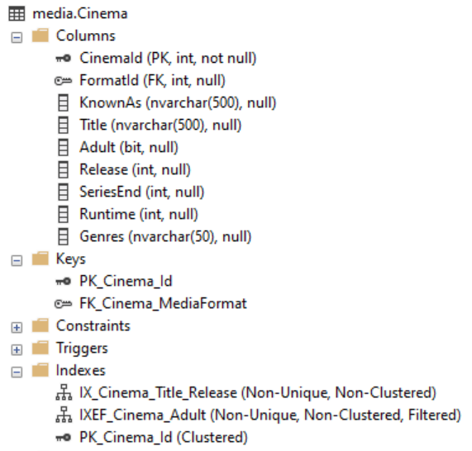
Collect Data Points
Data Definitions
Tables
Data Types
Foreign Keys
Indexes

Slide 14


High-Level Analysis
Rows | Table
107 | dbo | Language
11 | dbo | MediaFormat
15 | dbo | MediaRole
248 | dbo | Region
38,729,679 | media | AlternateTitle
1,973,781 | media | Cinema
59,134,691 | media | Crew
8,065,349 | media | Episode
10,037,253 | media | Person
1,402,539 | media | Rating
509,902 | media | Television
0 | media | ImportQueue
Row Count
Schema
Table Name
Cast & Crew
Made for TV
Correlation?

Slide 15
Collect Data Points
Sample Queries
SELECT cin.Title,
cr.CharacterName,
p.FirstName, p.Surname
FROM media.Cinema cin
INNER JOIN media.Crew cr
ON cin.CinemaId = cr.MediaId
INNER JOIN media.Person p
ON cr.PersonId = p.PersonId
WHERE cin.Title = 'The Lord of the Rings: The Fellowship of the Ring'
AND cr.CharacterName = 'Gandalf'
Multiple queries per table
Common search criteria
Execution counts
Resource usage stats

Slide 16
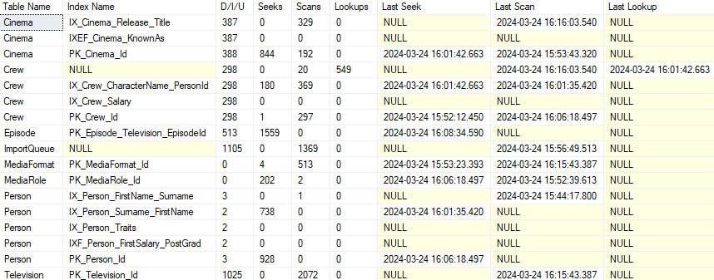
Collect Data Points
Index Usage Metrics
Delete/Insert/Update
Seeks
Scans
Lookups
Notes:
Mention offering up the scripts

Slide 17

“Continuous improvement is better than delayed perfection”

Slide 18




Create Your Lab
USE IMDb
SELECT distinct cin.Title [Movie]
FROM media.Cinema cin
INNER JOIN media.Crew cr
ON cin.CinemaId = cr.MediaId
WHERE cin.Title = 'NCIS'
Local SQL Instance
Locked Copy
Working Copy
Supports Tandem Scripts
USE IMDb_Working
SELECT distinct cin.Title [Movie]
FROM media.Cinema cin
INNER JOIN media.Crew cr
ON cin.CinemaId = cr.MediaId
WHERE cin.Title = 'NCIS'
Notes:
Go with larger DB so tipping points can be uncovered to handle growth

Slide 19
Basic Anatomy of a Query
Output
SELECT cin.Title,
cr.CharacterName,
p.FirstName, p.Surname
FROM media.Cinema cin
INNER JOIN media.Crew cr
ON cin.CinemaId = cr.MediaId
INNER JOIN media.Person p
ON cr.PersonId = p.PersonId
WHERE cin.Title = 'The Lord of the Rings: The Fellowship of the Ring'
AND cr.CharacterName = 'Gandalf'
Include or Lookup
Joins
Predicates & Search
Commonly keys

Slide 20
Primary Key
Unique, non-nullable constraint
Commonly an identity
Defaults as a clustered index
But doesn’t have to be!
ALTER TABLE [media].[Episode]
ADD CONSTRAINT [PK_Episode_Id]
PRIMARY KEY NONCLUSTERED ([EpisodeId] ASC)

Slide 21
Clustered Index
Unique or Non-Unique & Nullable
Physical order of data
Up to 1 per table
CREATE NONCLUSTERED INDEX [IX_Episode_Television_EpisodeId] ON [media].[Episode]([TelevisionId] ASC, [EpisodeId] ASC)

Slide 22
Nonclustered Index
Unique or Non-Unique & nullable
Aids with lookups
Easily abused
CREATE NONCLUSTERED INDEX [IX_Cinema_Title_Release] ON [media].[Episode]([Title] ASC, [Release] ASC)
Notes:
CREATE INDEX default

Slide 23

There is no
one
right move.

Slide 24


#1 - High Lookups
Index | Key Columns | Included Columns | Seek | Scan | Lookup
IXE_Episode_TelevisionId | TelevisionId ASC | Season, Episode | 1392 | 195 | 0
PK_Episode_Id (Clustered) | EpisodeId ASC |  | 0 | 413 | 890
1392
195
890
Index “insufficient”?
Better Candidate for Clustered?
Column order matters
Clustered Index ON Episode
(TelevisionId
,EpisodeId)
Notes:
EpisodeId isn’t NECESSARY if you’re keeping the PK separate

Slide 25
Make it Clustered?
Is the index…
And is the Clustered…
A Foreign Key column
Highest seeked
Very selective
Match other used ones
On an unused column
Mostly lookups and scans
Seeked at all
Notes:
5. Table with a secondary id as the first column for 5 dif indexes

Slide 26
Include Or Key
Example: Anatomy of a Query
Review all table’s scripts first!
Must apply to majority
Include » Detail Only
Key » Predicate or Join
SELECT cin.Title,
cr.CharacterName,
p.FirstName, p.Surname
FROM media.Cinema cin
INNER JOIN media.Crew cr
ON cin.CinemaId = cr.MediaId
INNER JOIN media.Person p
ON cr.PersonId = p.PersonId
WHERE cin.Title = 'The Lord of the Rings: The Fellowship of the Ring'
AND cr.CharacterName = 'Gandalf'

Slide 27







#2 – Foreign Keys
Media
Crew
People
Referential Integrity
Prevents Orphans
Cascade Delete
MediaId
No Action
PersonId
Beware: Cascade
Automatic Cleanup
Adds work to changes
Index These Keys

Slide 28
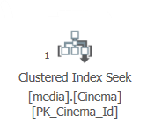
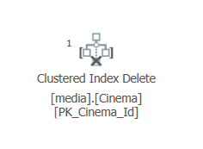
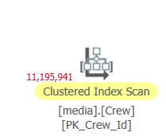
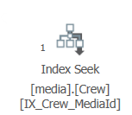
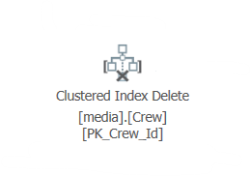
Why You Index The Keys
1. Delete From Cinema
Cascade
No MediaId Index
MediaId Index
Reads the entire table
to delete 1 row.
1
11,195,941
1
A row for a row
1
1
1

Slide 29
#3 – Low Read to Write
Index | DML | Seek | Scan
PK_ImportQueue_Id | 1604 | 0 | 482
IX_Person_EyeColor_FavoriteFood | 114 | 0 | 0
IXEF_Cinema_Adult | 209 | 0 | 0
IX_Crew_MediaId_Salary | 503 | 0 | 25
IX_Crew_MediaId_Salary_Title | 503 | 314 | 41
High in/out traffic table
No Seeks ≈ Missing Index
Bloat
Filtered?
Overlapping?

Slide 30
Aftermath
Index Usage
Reduced index footprint
Cleaned up heaps
4x read efficiency
50% reduction in lookups
 | Before | After
Indexes | 15 | 11
Heaps | 2 | 0
Seek:Scan | <1 : 1 | 4 : 1
Read:Lookup | 18 : 1 | 38 : 1

Slide 31
Aftermath – The Real Money
Query Performance
Before & After | Reads | CPU (ms) | Elapsed (ms)
Characters In a Movie | 519,250 | 3,578 | 1,550
 | 96 | 0 | 26
Average Actor’s Salary | 214,732 | 844 | 511
 | 1,066 | 0 | 180
Characters Played By Actor | 217,543 | 765 | 585
 | 1,100 | 16 | 217
All Episodes of a Show | 9,291 | 31 | 111
 | 12 | 0 | 236
Totals | 960,816 | 5,218 | 2,757
 | 2,274 | 16 | 659
Decreased Pressure
99.7% Reads
99.6% Compute
80% Elapsed

Slide 32




Summary
Work with your team
User Experience
Engineer Expectations
Get familiar with your resources
Set up a test lab
Before & After
Tandem Scripts
Start with Usage Metrics
High Lookups
Foreign Keys
Poor Read:Write Ratio

Slide 33
Thank You
@datacourt.bsky.social SereneFireSiren Courtney-Woolum
Information courtesy of IMDb (https://www.imdb.com). Used with permission.

Slide 34
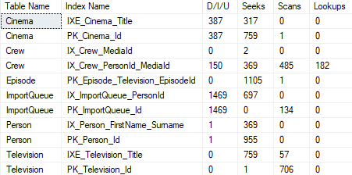
How Did We Do

